Slide 1
ESNA AGM 2023
Birmingham
Phil Tittensor

Slide 2
Executive
Chair – Phil Tittensor
Vice Chair/ Website Co-ordinator– Caryn Jory
Secretary – Debbie Coker
Membership Secretary – Sarah Tittensor
Treasurer and Conference Organiser – Carrie Burke
Locality Co-Ordinator –Dmitrij Peretz, Fiona Short, Sally-Ann Remnant (International)
Research and Development/Education – Nikki Heenan, Kathryn Colman, Sally-Ann Remnant.
Charities and Alliance Link – Nikki Heenan/ Kathryn Colman

Slide 3
Agenda
Message from the Chair
Membership
Website
Locality Groups
Treasurer
Constitution
Competencies
Midazolam Guidelines
AOB

Slide 4
Update from the Chair
With thanks
Catherine Doherty
Welcome
Dimitrij Peretz
Fiona Short
2023 highlights
ESN competencies (ratified at last!)
Fast Facts – adult released 2022, paediatric release date Autumn 2023, ID, gender specific & FND in discussion
Interim midazolam guidelines
International developments (ILAE, European Roadmap etc)
Valproate situation
Edinburgh Napier PG Cert

Slide 5
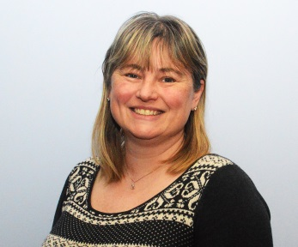
Membership update
We now have 418 members of ESNA (including 2 international members). We are looking at helping our German colleagues to set up an ‘ESNA type’ in Germany as they have nothing similar.
We are ‘live’ on Facebook and twitter (we have 760 followers on twitter, including the ILAE and CQC). We are using this multi-media approach to boost membership but also put out current research and information such as job opportunities.
Contact email address-sarah.tittensor@outlook.com

Slide 6
Website
www.esna-online.org

Slide 7
Locality Groups
North West – North West of England, including, Merseyside, Greater Manchester, Cumbria, Cheshire, Lancashire and some members from Staffordshire - Active
North East – Active
Epilepsy Awareness Eastern Group (EAGER) - East Anglia and surrounding area - Active
London (LENS)-Active
Kings, Kent and Sussex (KKS) - Active
Wessex – Hampshire, Isle of Wight, Wiltshire, Berkshire –Active
South West (SWENG) – Cornwall, Devon, Somerset, Dorset and Jersey -Active

Slide 8
Locality Groups
Midlands – Milton Keynes, Oxford, Birmingham, Coventry, Northampton currently not meeting ?
Scotland – Active
Welsh Epilepsy Nurses (WEN) – Active
Northern Ireland ?
Republic of Ireland-Active
Contact: ESNAepilepsynursesassociation@outlook.com; dmitrij.peretz@nhs.net

Slide 9
Locality Groups
Plan:
to invite locality groups leaders once a year to ESNA Exec committee meeting
locality groups to have more involvement in various ESNA projects – we need to hear from you,
Look out on Weekly Round-up from ESNA.

Slide 10
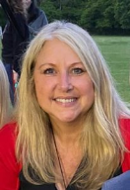
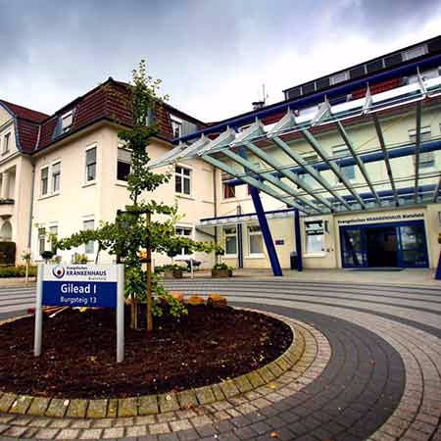
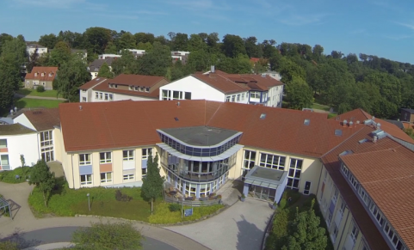
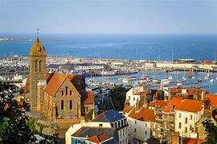
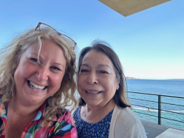
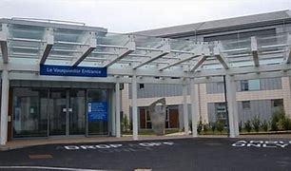
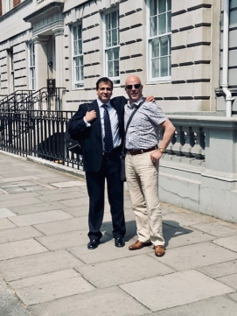
International ESNA
Working with two nurses from Germany- to set up regional meetings/support.
Guernsey and potentially other Channel islands ESNA regional meetings/support.
Reaching out to help Nurses develop epilepsy nurse roles in Slovakia.
Brainway: A new roadmap for Epilepsy in UK-Italian embassy.
Launched in 2018 in collaboration with the Think Tank The European House-Ambrosetti, Headway is an initiative on Brain Health (incl. Mental Health and Epilepsy), with the aim of creating a multidisciplinary platform for strategic reflection, analysis, dialogue and comparison between various European experiences in the management of individuals with mental and neurological disorder/Epilepsy. Moving forward to share a collective approach to care.
Bielefeld Germany
Guernsey and Princess Elizabeth Hospital
Italian Embassy June 23

Slide 11
Future Conferences
Next conferences
Wider geographical access based on previous feedback from members
Have your say!

Slide 12
ESNA Finances 2022-2023 Carrie Burke – ESNA Treasurer Business current account/Business Savings account/PayPal account
INCOME
Membership fees
Treatment & Prescribing Day fees
Sponsorship for conferences/meetings
Sponsorship/grants/income for other projects e.g. Fast Facts books, virtual college course
EXPENDITURE
Treatment & Prescribing Day & Conference costs
Secretarial support
F2F executive meeting costs
Gift for retiring exec team member
As of 29/6/23 :
Current Account – £6,849.11
Savings Account – £32,429.71
PayPal account - £389.82

Slide 13
Constitution
Discussion – proposed changes:
Yearly review at 1st meeting of year for Committee
Every 5 years a full review of constitution.
Have to be a member for minimum of 2 years before applying for Executive
There will be 11 committee members to ensure outcome of votes and size of ESNA
In exceptional circumstances the committee will invite members to apply for specific roles.
Can be found on ESNA website.

Slide 14
Competencies
Adults
Paediatric
Learning Disabilities
Ratified and approved.

Slide 15
Midazolam Guidelines
reviewed and updated,
However, this is an intermediate Guideline. Reviewing with EA ready for 24/25.
We have so far incorporated Train the Trainer
It will be ratified by ILAE and Psychiatry
It will be supported by CQC

Slide 16
AOB
Invites from the floor

