Slide 1

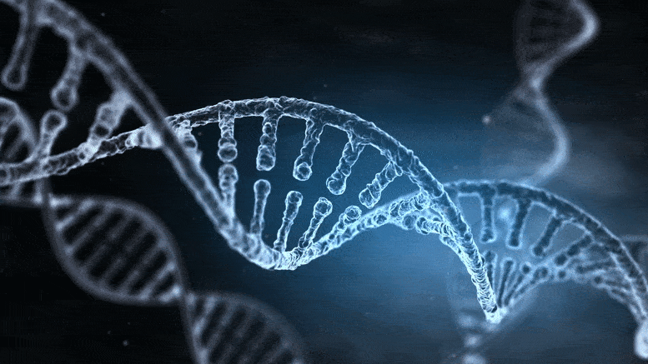
Fundamentals of Genetics and Genomics
Crash Course
Mark Mencias RN MSc
Neurogenetics Clinical Nurse Specialist
24th June 2024
Notes:
Introduction about module and topic

Slide 2

Introduction
Neurogenetics Clinical Nurse Specialist
Nurse-Led Neurogenetics Clinic
Base: Atkinson Morley Regional Neuroscience Centre
South East Genomics Medicine Service Alliance
Mainstream genomics in clinical neurology
  Neuromuscular disorders
  Genetic epilepsies
  Movement disorders
  Cognitive disorders
  Paroxysmal CNS disorders
  Mitochondrial disorders
Researcher (particularly in rare & ultra rare diseases; drug development; bioinformatics)
Workforce upskilling & higher education.
Mark Mencias RN MSc
Neurogenetics Clinical Nurse Specialist
Fundamentals of Genetics and Genomics (Genomics Nursing)
St George’s University Hospitals NHS Foundation Trust

Slide 3



Reaction about Genetics and Genomics
Fundamentals of Genetics and Genomics (Genomics Nursing)
St George’s University Hospitals NHS Foundation Trust
Notes:
Healthcare professionals react in various ways about topics that they may not necessarily have mastery. However, we encounter genetics and genomics on a regular basis. Nurses, in particular, will be exposed to the fundamentals of biology (i.e. genetics and genomics) and therefore there is an increasing impetus to emphasise the role of genetics & genomics to nursing and vice versa.

Slide 4
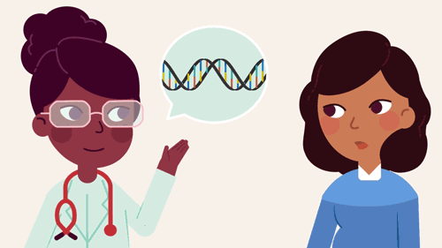
Learning Outcomes
Gain an understanding of the basics of genetics and genomics
Identify the processes involved in cell division and protein synthesis.
Explore the impact of genetics and genomics in providing healthcare.
The role of nurses in the genomic medicine era.
Fundamentals of Genetics and Genomics (Genomics Nursing)
St George’s University Hospitals NHS Foundation Trust

Slide 5


Goal at the end of the lecture
Fundamentals of Genetics and Genomics (Genomics Nursing)
St George’s University Hospitals NHS Foundation Trust
Notes:
It is a complex topic. However, my hope would be that by the end of the lecture, we would be able to equip you with the fundamental knowledge of genetics and genomics to be able to apply it to your nursing practice (and remain calm & collected whenever it comes up). Even better, if some of you would consider developing in to this specialist role in the future.

Slide 6
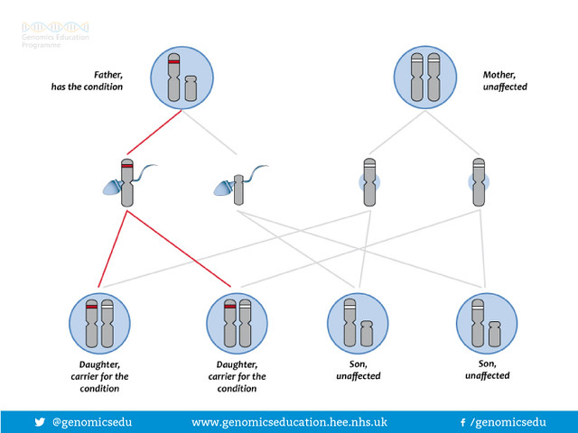
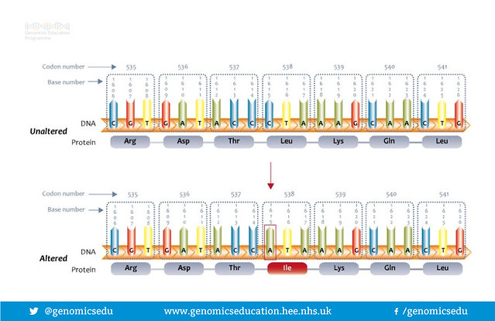
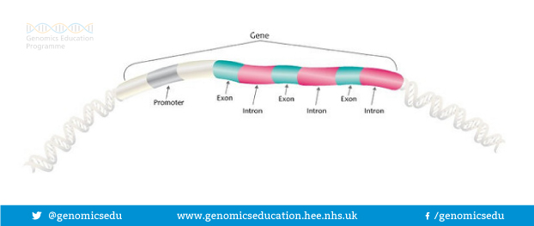
Genetics
Genes: function & composition
Heredity: inheritance
Variation: Difference in DNA sequences between individuals
Fundamentals of Genetics and Genomics (Genomics Nursing)
Notes:
Genetics is the study of genes, heredity, and genetic variation. Gene is the basic unit of heredity and is composed of organic molecules called nucleotides. Genes make up about 1-5% of a human being’s genome.

Slide 7
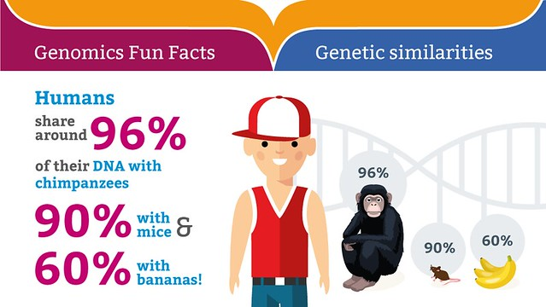
Genetics
Fundamentals of Genetics and Genomics (Genomics Nursing)

Slide 8
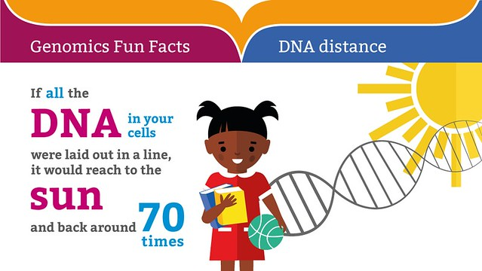
Genetics
Fundamentals of Genetics and Genomics (Genomics Nursing)

Slide 9
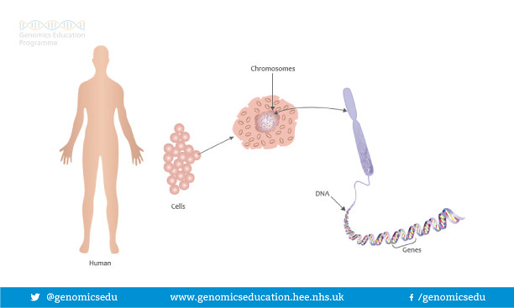
Genomics
Complete set of genetic information
20000 to 25000 genes
Fundamentals of Genetics and Genomics (Genomics Nursing)
Notes:
Genomics is the study of an organism’s complete set of genetic information.
There are 3.2 billion base nucleotides that make the DNA, of which there are 20,000 to 25,000 genes

Slide 10
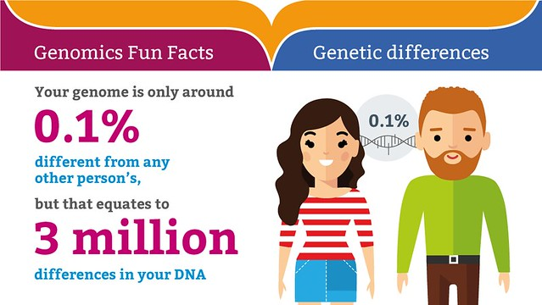
Genomics
Fundamentals of Genetics and Genomics (Genomics Nursing)
Notes:
Genomics is the study of an organism’s complete set of genetic information.
There are 3.2 billion base nucleotides that make the DNA, of which there are 20,000 to 25,000 genes

Slide 11
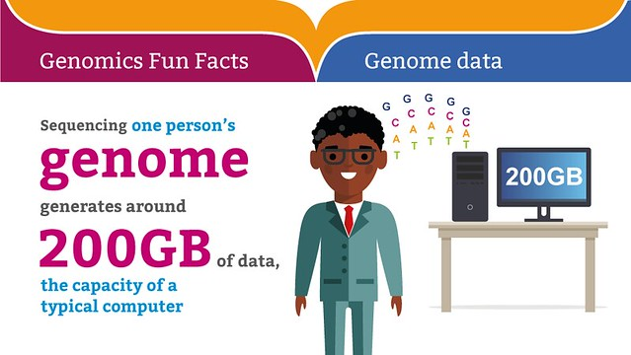
Genomics
Fundamentals of Genetics and Genomics (Genomics Nursing)
Notes:
Genomics is the study of an organism’s complete set of genetic information including of exons & introns.
There are 3.2 billion base nucleotides that make the DNA, of which there are 20,000 to 25,000 genes

Slide 12
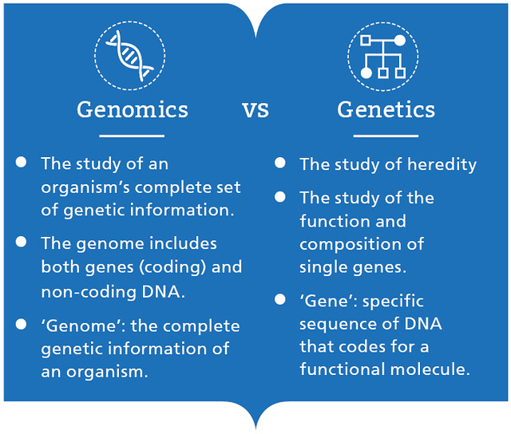
Genetics vs Genomics
Fundamentals of Genetics and Genomics (Genomics Nursing)
St George’s University Hospitals NHS Foundation Trust
Notes:
Direct comparison of genomics and genetics

Slide 13
Central Dogma of Biology
DNA
Transcription
RNA
Translation
Protein
Fundamentals of Genetics and Genomics (Genomics Nursing)
Notes:
DNA contains the genes which provides the instructions to produce the various proteins that is necessary for the survival of a specie. There are 2 main processes that govern this: transcription & translation.

Slide 14
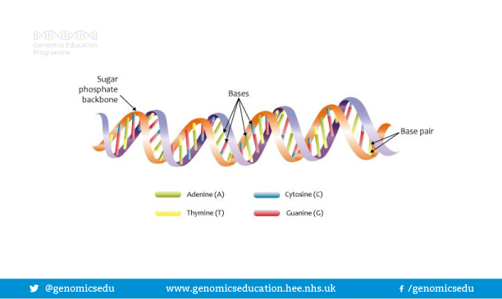
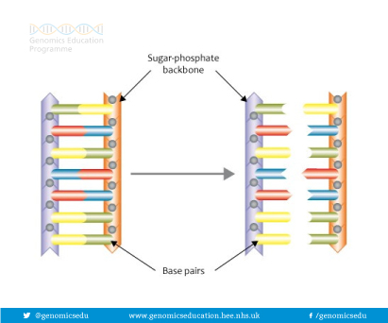
Deoxyribonucleic acid (DNA)
Double stranded
Nucleotides
Double helix
Sugar & phosphate groups
Fundamentals of Genetics and Genomics (Genomics Nursing)
St George’s University Hospitals NHS Foundation Trust
Notes:
A DNA is a organic macromolecule composed of 2 chains of nucleotides. Nucleotides are made up of (nitrogen) base, sugar, and phosphate groups. A DNA molecule is sometimes compared to a twisted ladder due to its double helix appearance. This is the backbone of the DNA structure and is formed by alternating chains of sugar and phosphate units. The bases are linked to the sugar and each base to its complementary base to form the ‘rungs of the ladder’. The double helix is wrapped around histones to help the DNA maintain its shape which then turns into chromatin.

Slide 15
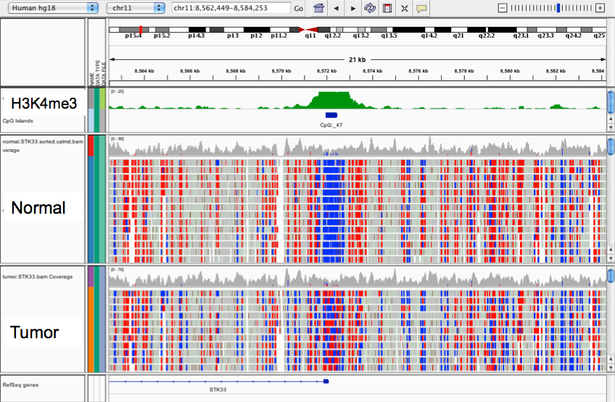
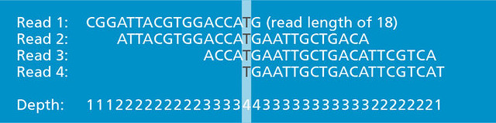
Genetic Code
Fundamentals of Genetics and Genomics (Genomics Nursing)
St George’s University Hospitals NHS Foundation Trust
Notes:
The DNA carries a huge amount of information that determines all the biological activities of an organism. This information is kept in the nitrogen bases in the DNA. There are 4 bases:
Adenine (A) <purine>
Thymine (T) <purine>
Cytosine (C) <pyrimidine>
Guanine (G) <pyrimidine>
These are arranged in a precise order along the DNA making a code that can be read when protein synthesis is required. Each base pairs with a base on the other strand in a predictable and precise way (Complementary base pairing). The bases on opposite strands bind to each other with hydrogen bonds. Adenine always pairs with Thymine. Cytosine always pairs with Guanine.

Slide 16
Genes
Fundamentals of Genetics and Genomics (Genomics Nursing)
St George’s University Hospitals NHS Foundation Trust
Notes:
The DNA contains filler sequences and sequences that code for proteins. The filler sequences makes up 99% of the cell DNA and contains signals to start and stop protein synthesis. The filler sequences are interspersed along the DNA. Intergenic regions contain a stretch of the DNA located between genes and has functional elements i.e. promoter, enhancer, activators, repressors, terminator. Exons is the sections of the gene which codes for an amino acid. Introns are sections within the gene that is removed but has an important role in joining exons to create one stretch of instruction.
Each gene allows the cell to make a specific complex protein. Genes normally exist in pairs because there is a gene on the paired chromosome at the equivalent site.

Slide 17
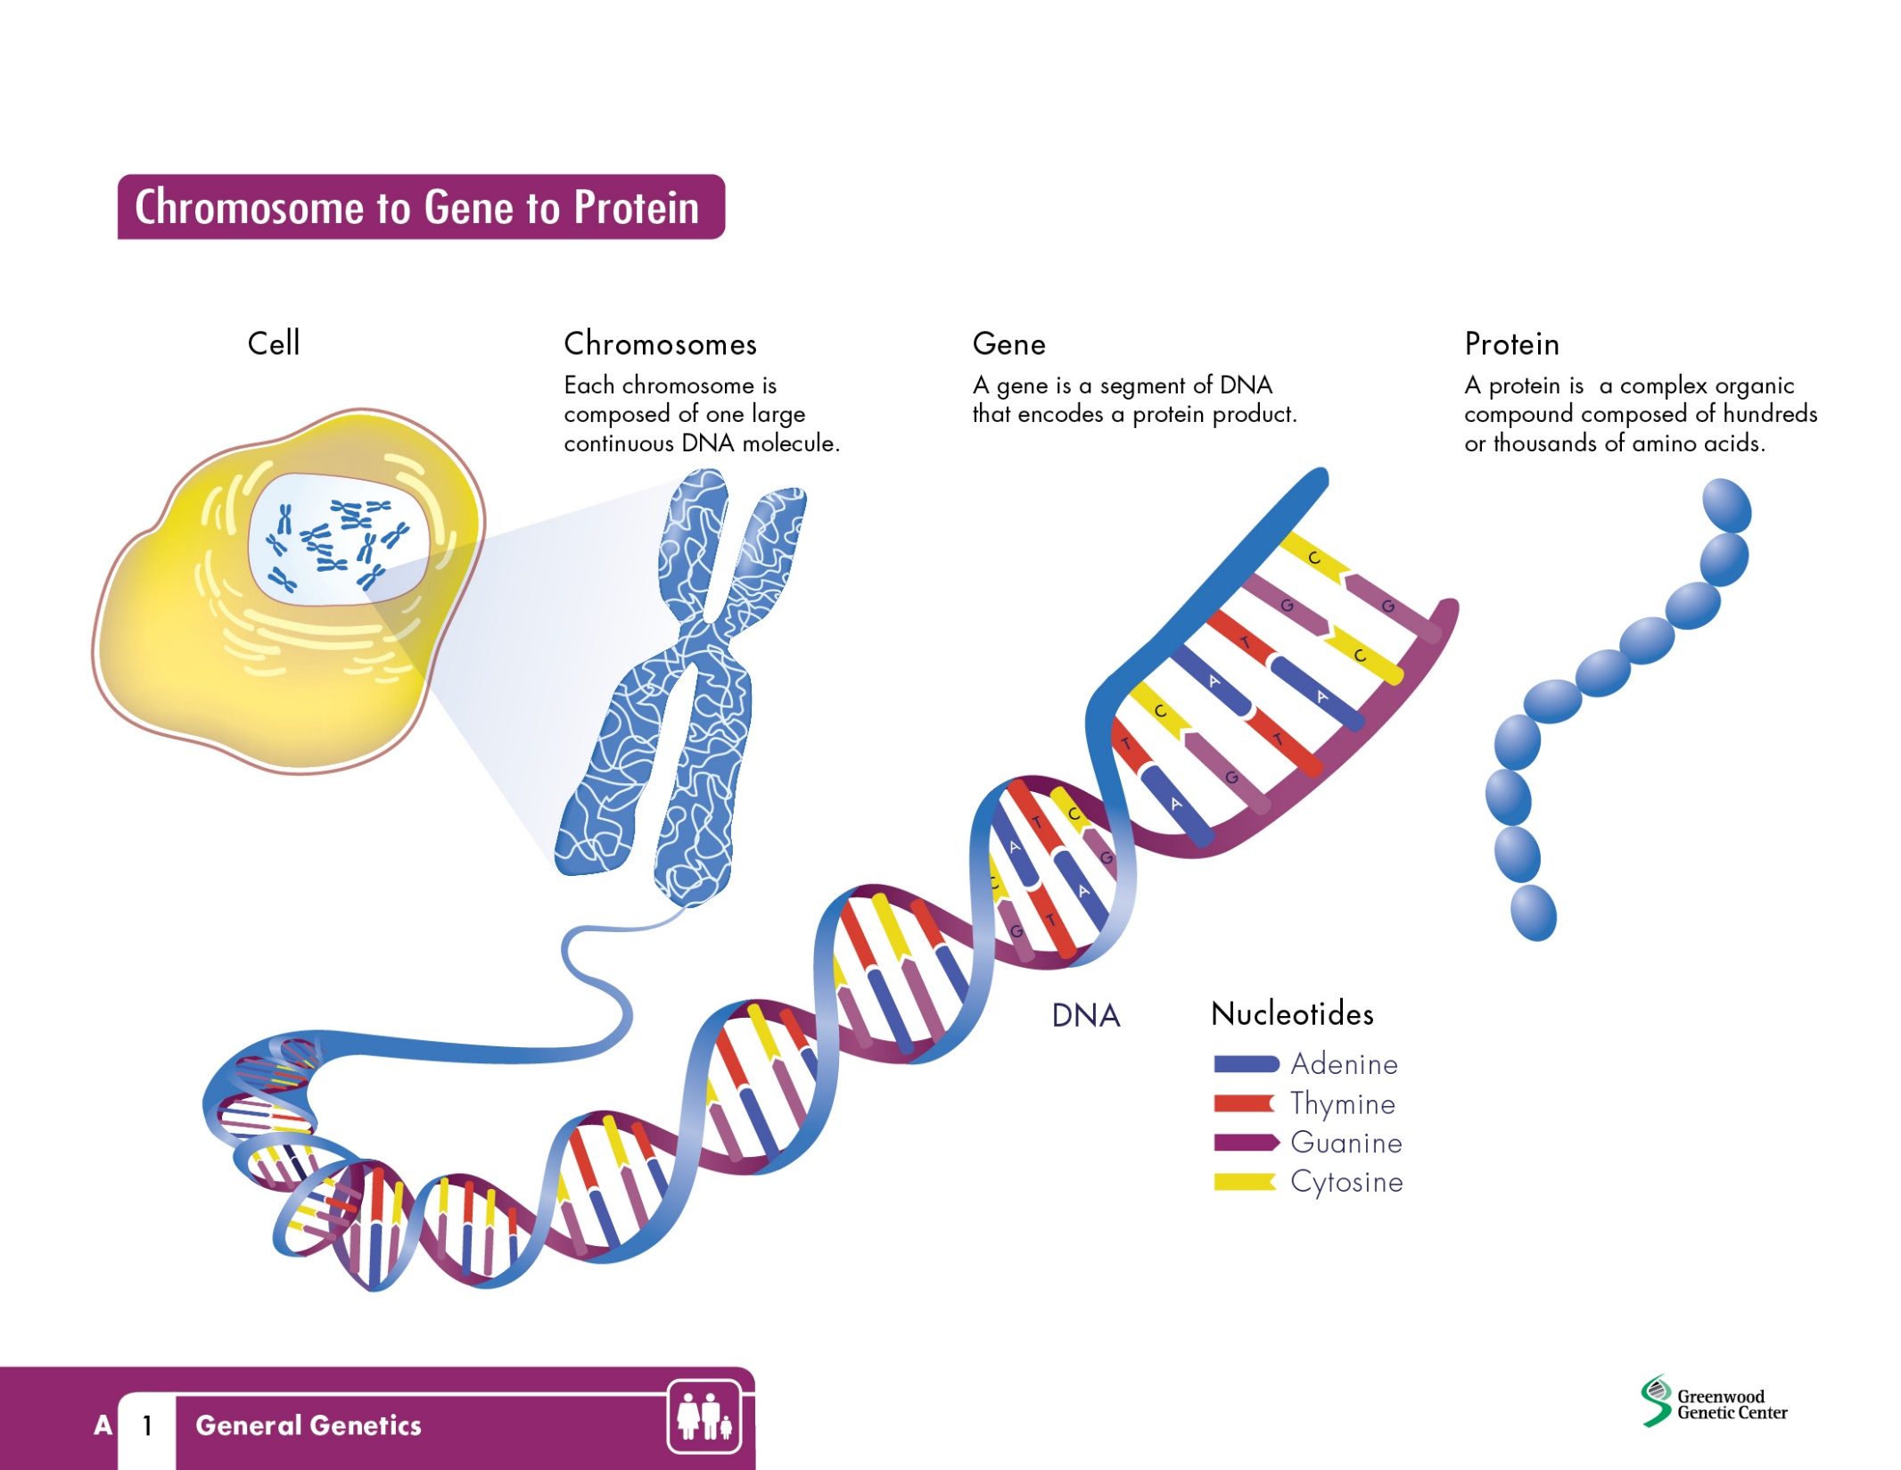
Chromosomes
Fundamentals of Genetics and Genomics (Genomics Nursing)
St George’s University Hospitals NHS Foundation Trust
Notes:
Nearly every cell in the body contains the individual’s genome in the nucleus. The exception to this are red blood cells that do not contain a nucleus and the sex cells (gametes). In a resting cell the chromatin (genetic material) is diffuse and hard to see. As the cell prepares to divide the chromatin is collected into sausage shaped structures called chromosomes. Each chromosome is one of a pair; inherited from each parent. The human cell has 46 chromosomes which are organized into 23 pairs

Slide 18
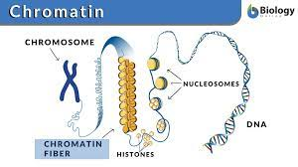
Chromosomes to Chromatin to DNA
Fundamentals of Genetics and Genomics (Genomics Nursing)
St George’s University Hospitals NHS Foundation Trust
Notes:
Chromosomes are made from tightly coiled DNA and supporting proteins called histones. If it was uncoiled there would be a length of 2 metres of DNA in each cell. Each end of the chromosome is capped with a length of DNA called a telomere.

Slide 19
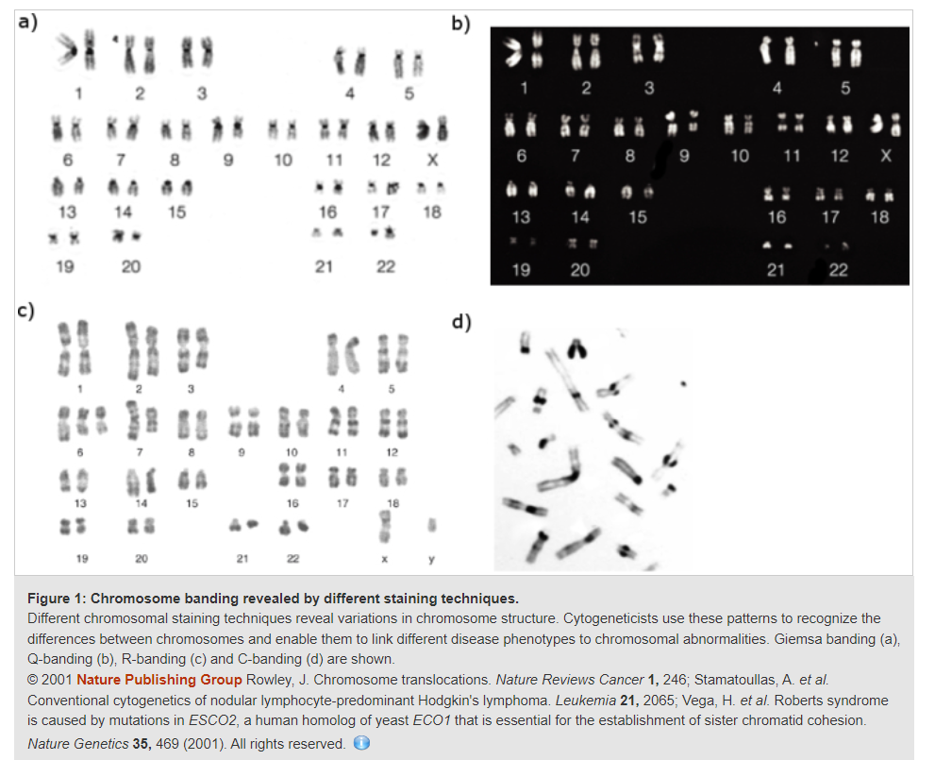
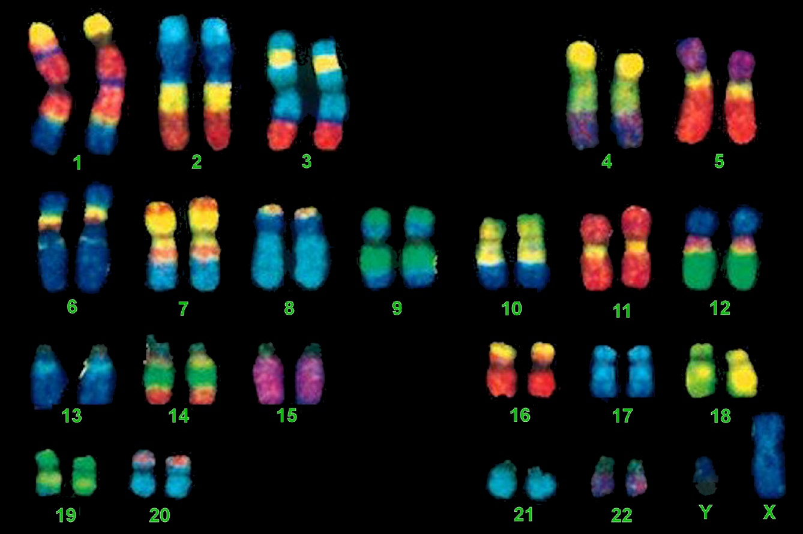
Chromosome Staining & Karyotyping
Fundamentals of Genetics and Genomics (Genomics Nursing)
St George’s University Hospitals NHS Foundation Trust
Notes:
A cell with 23 pairs of chromosomes is called diploid. Sex cells (gametes) only have 23 chromosomes and are called haploid. Chromosomes that belong to the same pair are called homologous chromosomes. The complete set of chromosomes from a cell is called a karyotype. The first 22 pairs of chromosomes are known as autosomes as each chromosome contains the same amount of genetic material. Chromosome 23 are the sex chromosomes. The sex chromosomes determines the biological sex of an organism. The Y chromosome is shorter than the X and is carried only by males. Females have 2 X chromosomes (XX). Males have 1 X and 1 Y chromosome (XY)

Slide 20
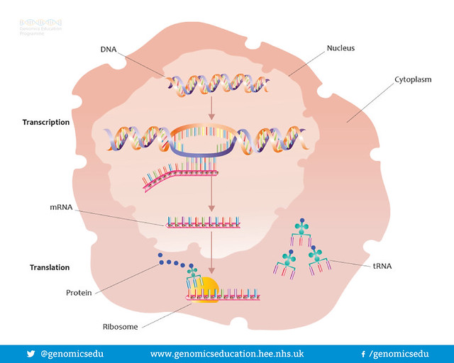
Protein Synthesis
Fundamentals of Genetics and Genomics (Genomics Nursing)
St George’s University Hospitals NHS Foundation Trust
Notes:
Proteins are essential to all aspects of body function, forming major structural elements of the body and enzymes essential for biochemical processes. The cells DNA is too big to leave the nucleus, therefore an intermediary molecule is needed to carry the genetic instructions from the nucleus to the cytoplasm where proteins are made. This intermediary molecule is called messenger ribonucleic acid.

Slide 21
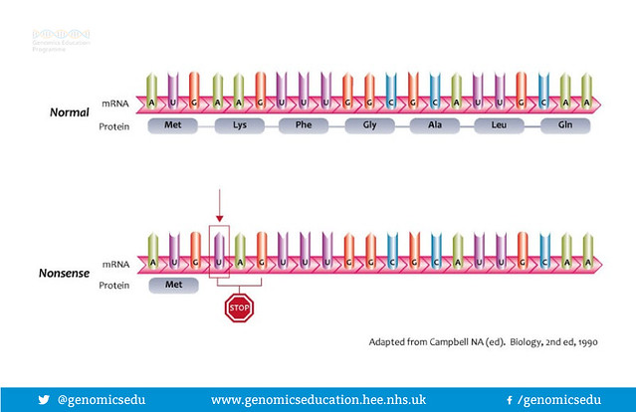
Messenger Ribonucleic Acid (mRNA)
Fundamentals of Genetics and Genomics (Genomics Nursing)
St George’s University Hospitals NHS Foundation Trust
Notes:
mRNAs are single stranded chain of nucleotides synthesized in the nucleus from the appropriate gene whenever the cell needs to make the protein for which that gene codes. Using the DNA as a template a piece of mRNA is made from the gene to be used in a process called transcription. The mRNA then leaves the nucleus and carries it’s information to the ribosomes in the cytoplasm.
mRNA is different from DNA in 3 different ways:
Single stranded
Contains the sugar ribose instead of deoxyribose
Uses the base uracil instead of thymine

Slide 22
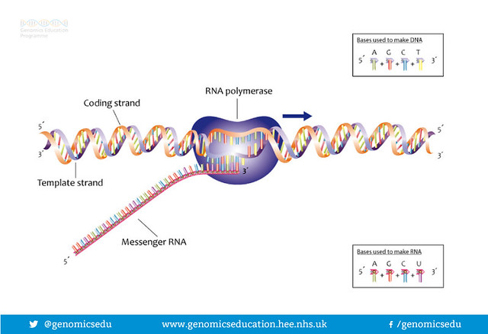
Transcription
Fundamentals of Genetics and Genomics (Genomics Nursing)
St George’s University Hospitals NHS Foundation Trust
Notes:
Transcription is the process of copying a segment of the DNA into RNA. First step is to open up the DNA helix to expose the bases. Only the gene to be transcribed is opened, the remainder of the chromosome remains coiled. The enzyme that makes the mRNA molecule moves along the opened DNA strand reading its code and adding the complementary base to the mRNA. When the enzyme reaches a stop signal it terminates synthesis of the mRNA and releases it. The DNA is closed and the mRNA leaves the nucleus

Slide 23
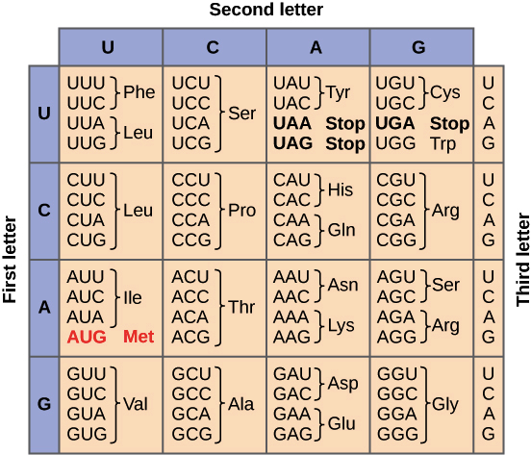
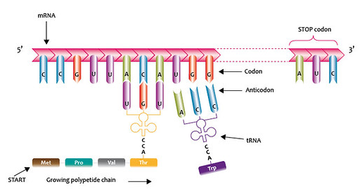
Translation
Fundamentals of Genetics and Genomics (Genomics Nursing)
St George’s University Hospitals NHS Foundation Trust
Notes:
Translation is the synthesis of the protein using information carried on the mRNA. It takes place on free ribosomes in the cytoplasm and those attached to the rough endoplasmic reticulum. The mRNA attaches to the ribosome and the Ribosomes reads the base sequence of the mRNA. Proteins are built from up to 20 different amino acids so it is not possible to use the 4 bases individually. To give enough options the base code in the RNA is read in triplets. This gives a possible 64 base combinations. Each of these triplet sequences is called a codon.

Slide 24
Translation
Fundamentals of Genetics and Genomics (Genomics Nursing)
St George’s University Hospitals NHS Foundation Trust
Notes:
The first codon is called a start codon, this initiates protein synthesis. The ribosome continues reading the codons and adding the appropriate amino acids to the growing protein molecule until it arrives at a stop codon. The ribosome then stops the synthesis and releases the protein. Some new proteins are used in the cell and some are exported for use outside of the cell.

Slide 25
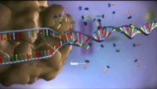
From DNA to Protein
Fundamentals of Genetics and Genomics (Genomics Nursing)
St George’s University Hospitals NHS Foundation Trust
Notes:
Play the video.

Slide 26
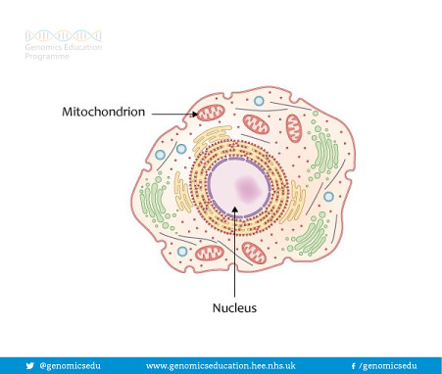
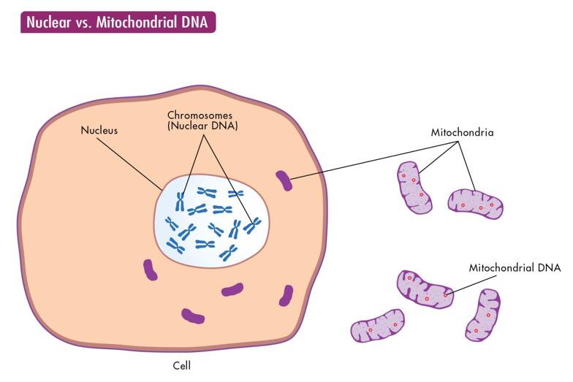
Mitochondrial DNA
Fundamentals of Genetics and Genomics (Genomics Nursing)
St George’s University Hospitals NHS Foundation Trust
Notes:
The DNA in the nucleus is called nuclear DNA. However, the nucleus is not the only organelle which contains DNA. The mitochondria also holds DNA which it uses for cellular function. The mitochondrial DNA is not inherited in the same manner as the nuclear DNA. Each cell has approximately 5000 mitochondria.

Slide 27
Cell Division
Fundamentals of Genetics and Genomics (Genomics Nursing)
St George’s University Hospitals NHS Foundation Trust
Notes:
The process for which a cell could generate new DNA material is through cell division. Most body cells are capable of cell division. Cell division usually leads to the production of 2 identical daughter cells by the process of mitosis and is important in body growth and repair. Production of gametes is different as daughter cells only have half of the normal chromosome number. This process is called meiosis.

Slide 28
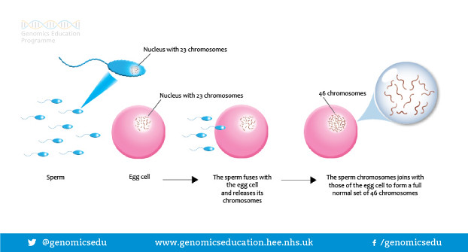
Fertilisation
Fundamentals of Genetics and Genomics (Genomics Nursing)
St George’s University Hospitals NHS Foundation Trust
Notes:
On fertilisation the male and female gametes unite, as the gametes are both haploid, the resulting zygote is diploid

Slide 29
Genetic Basis of Inheritance
Fundamentals of Genetics and Genomics (Genomics Nursing)
St George’s University Hospitals NHS Foundation Trust
Notes:
The mix up of genes during meiosis leads to a huge genetic variety in the human race
Autosomal inheritance:
Each pair of homologous chromosomes contain genes for the same traits. Because one chromosome of each pair is inherited from the father and one from the mother an individual has two genes controlling the same trait
These paired genes are called alleles. Corresponding alleles contain genes concerned with the same trait but they may not be identical. An individual may have
Two identical forms of the gene (homozygous)
Two different forms of the gene (heterozygous)

Slide 30
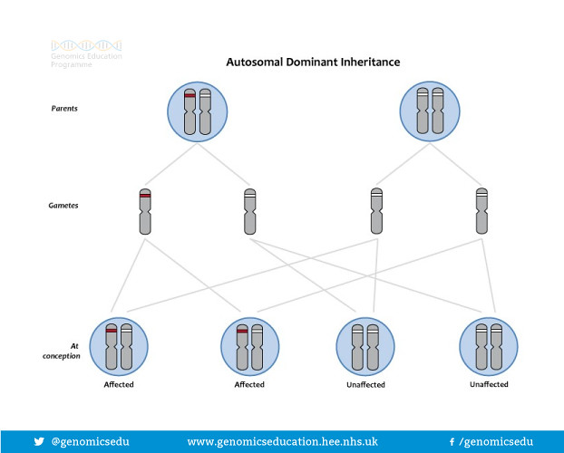
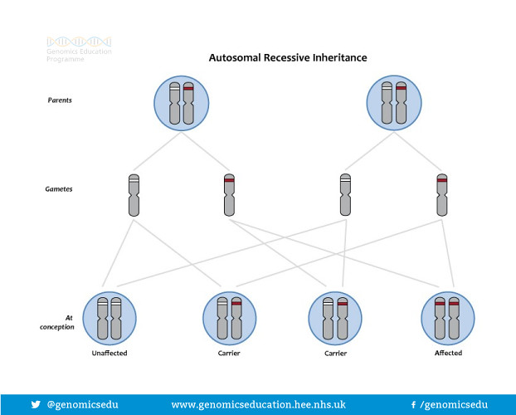
Gene Dominance
Fundamentals of Genetics and Genomics (Genomics Nursing)
St George’s University Hospitals NHS Foundation Trust
Notes:
Genes are either dominant or recessive. Dominant genes are always expressed over recessive genes. Only one dominant gene is required for that characteristic to be expressed. A recessive gene will only be expressed as a characteristic if it is present on both chromosomes.

Slide 31
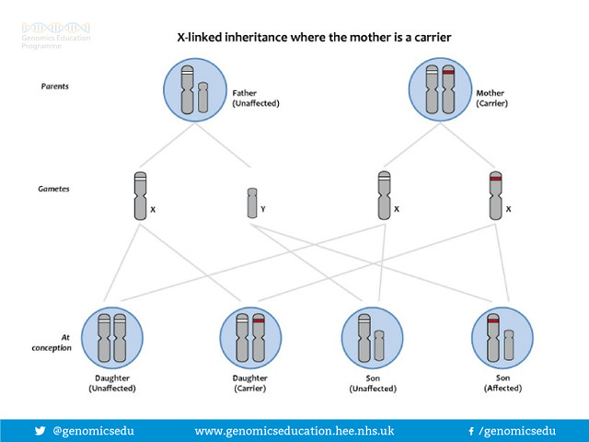
Sex-Linked Inheritance
Fundamentals of Genetics and Genomics (Genomics Nursing)
St George’s University Hospitals NHS Foundation Trust
Notes:
The Y chromosome is smaller than the X chromosome and carries less genes. This means that a male has only one copy of most of the genes on his sex chromosome. Traits coded for on the x chromosome with no corresponding material on the Y are said to be sex linked.

Slide 32
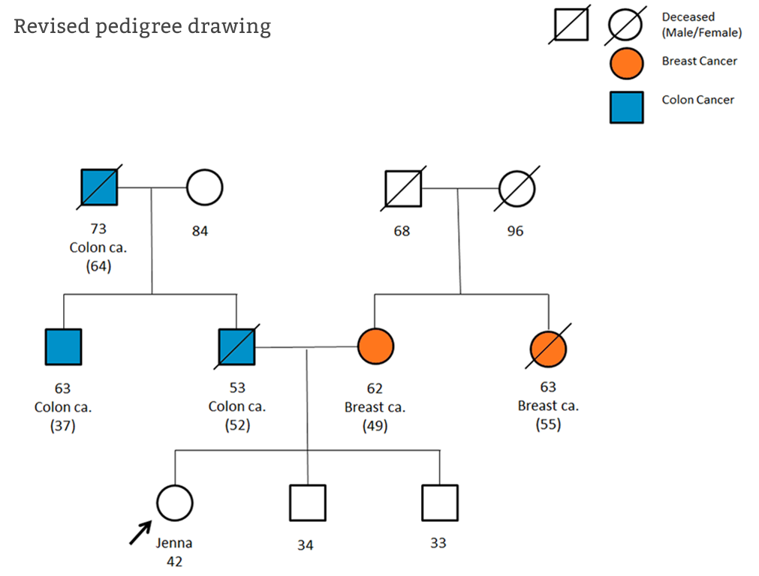
Genetic Family History Assessment
Fundamentals of Genetics and Genomics (Genomics Nursing)
St George’s University Hospitals NHS Foundation Trust

Slide 33
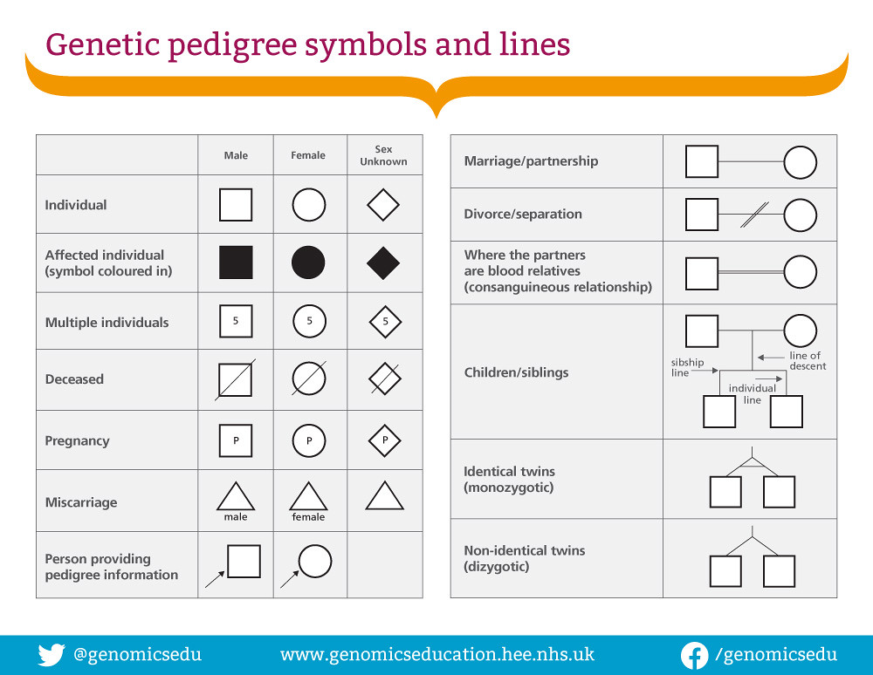
Fundamentals of Genetics and Genomics (Genomics Nursing)
St George’s University Hospitals NHS Foundation Trust
Notes:
Genetic pedigree symbols are used to draw up a family tree and indicate familial relationship, sex, etc.

Slide 34
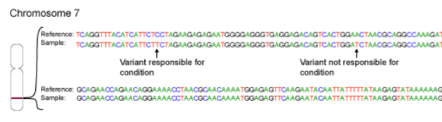
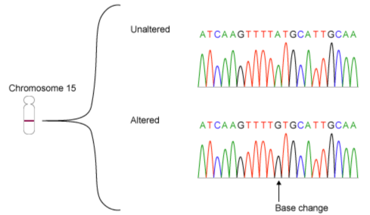
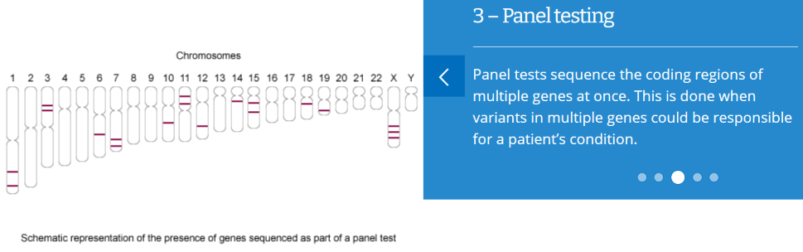
Genetic Testing
Single Gene Testing
Target Variant Testing
Gene Panel Testing
Fundamentals of Genetics and Genomics (Genomics Nursing)
St George’s University Hospitals NHS Foundation Trust
Notes:
Genetic testing examines for any variations that could explain the genetic cause of a person’s health condition. Genetic testing also provides information how a particular genetic condition could be passed from one generation to the next. There are different types of genetic tests available.
Target Variant Testing – Only a small part of the gene is read and analysed. This is usually done if the genetic condition (and mutation) is already known to the family
Single Gene Testing – A single gene is read and analysed. This is usually done for certain conditions that has a clear clinical signs and symptoms indicating that it is a genetic condition (e.g. Huntington’s disease – HTT gene triplet repeat)
Gene Panel Testing – A set number of genes associated a group of conditions (e.g. hereditary neuropathies; hereditary ataxia) is analysed and read.

Slide 35
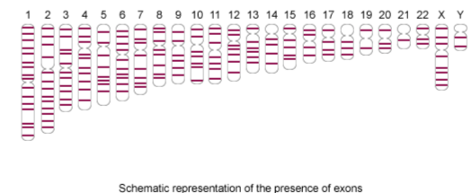
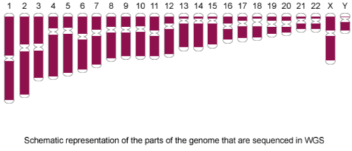
Genetic Testing
Whole Exome Sequencing
Karyotyping
Whole Genome Sequencing
Fundamentals of Genetics and Genomics (Genomics Nursing)
St George’s University Hospitals NHS Foundation Trust
Notes:
Genetic testing examines for any variations that could explain the genetic cause of a person’s health condition. Genetic testing also provides information how a particular genetic condition could be passed from one generation to the next. There are different types of genetic tests available.
Karyotyping – looks at structural abnormalities in the chromosomes (e.g. trisomy 21 in Down’s syndrome)
Whole exome sequencing – investigates all exomes in the genome.
Whole genome sequencing – examines for variants in the entire genome.

Slide 36
Impacts of genetic testing to the patient
Physical
Psychological
Social
Emotional
Fundamentals of Genetics and Genomics (Genomics Nursing)
St George’s University Hospitals NHS Foundation Trust
Notes:
Questions that may come up when a person undergoes genetic testing and counselling.
What does the result mean?
What is known about this condition and/or gene?
What does this mean for me and my child’s future?
What does this result mean for my family members?
Could this happen again?
Are there any treatments or preventative measures that can be taken?
What is the likelihood of severe complications?
How can we learn more about this?
How do I know if the information I am reading or hearing is accurate?

Slide 37
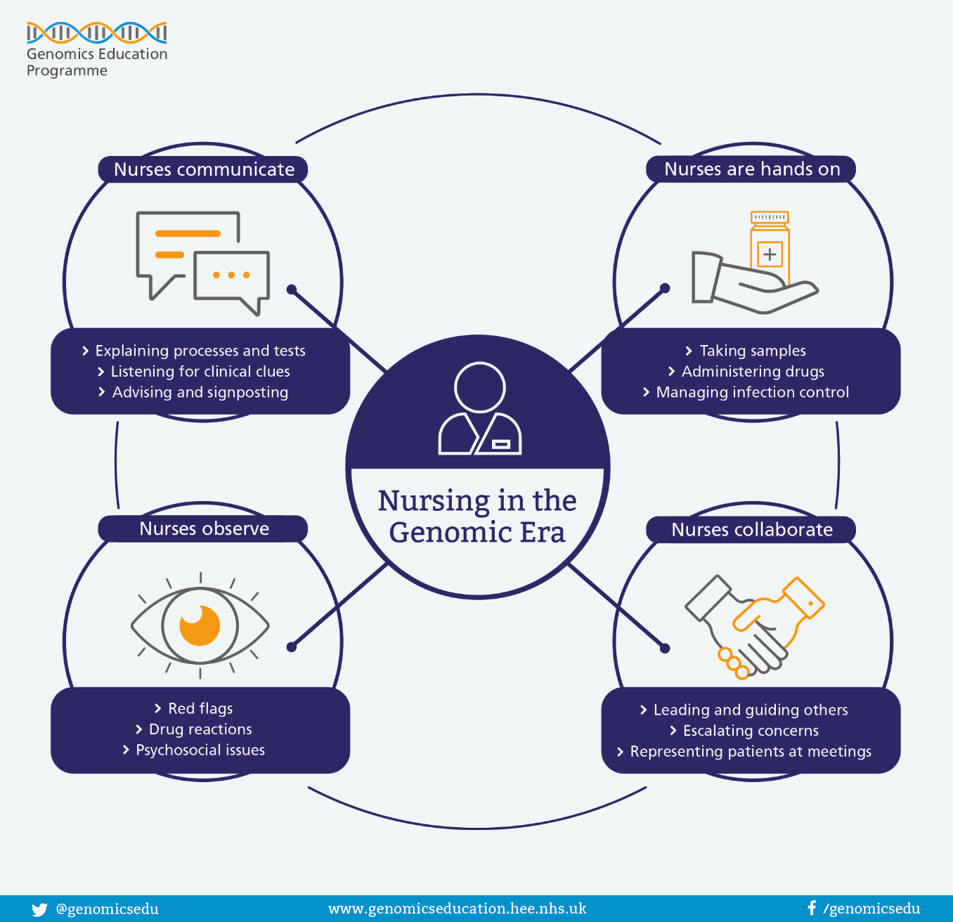
The role of nurses in genetics and genomics
Fundamentals of Genetics and Genomics (Genomics Nursing)
St George’s University Hospitals NHS Foundation Trust
Notes:
Managing expectations about testing:
Gauge the patient’s perspective
Consider potential outcomes
Explore the impact of diagnosis
Establish a follow-up plan

Slide 38
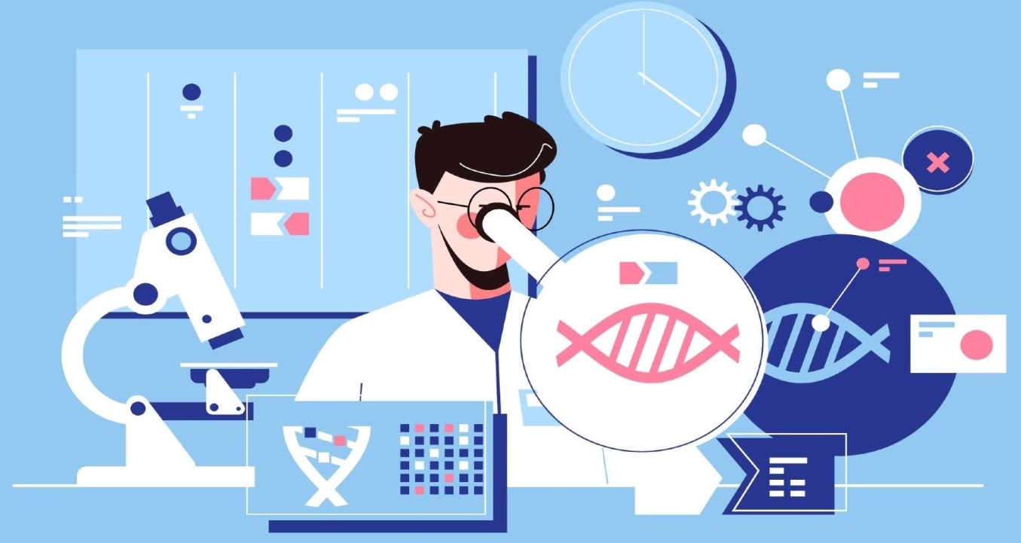


A day in the life of a
Genetics Clinical Nurse Specialist
“A genetics nurse is a licensed professional nurse with special education and training in genetics. Genetics nurses help people at risk for or affected by diseases with a genetic component to achieve and maintain health. “
Fundamentals of Genetics and Genomics (Genomics Nursing)
St George’s University Hospitals NHS Foundation Trust
Notes:
The NHS introduced genetics CNS to help support patients who are undergoing genetic testing. As a genetics CNS my practice have 4 main themes:
Clinical – provide genetic counselling, genetic risk assessment, psychosocial assessment, family history taking & review
Education – teaching students and healthcare professionals about the role of genetics and genomics in healthcare service
Management – developing nurse-led service and quality improvement initiatives related to rare diseases
Research – identifying suitable participants to clinical trials; expanding the knowledge base in genetics and genomics in nursing and healthcare services
References:
1. International Society of Nurses in Genetics (2022) What is a genetics nurse? International Society of Nurses in Genetics. https://www.isong.org/page-1325153. Accessed: 25/09/2022

Slide 39
Transforming Healthcare Outcomes
Better coordination of care and support
Improving access to specialist care, treatment & research
Increase awareness of rare diseases through education
Helping patients get a final diagnosis
Fundamentals of Genetics and Genomics (Genomics Nursing)
St George’s University Hospitals NHS Foundation Trust
Notes:
Ultimately, the genetics nurse intends to transform the health outcomes of patients with rare inherited conditions in line with priorities outlined in the The UK Rare Diseases Framework.
References:
1. Department of Health and Social Care (2021) The UK Rare Diseases Framework. Department of Health and Social Care. https://www.gov.uk/government/publications/uk-rare-diseases-framework/the-uk-rare-diseases-framework. Accessed: 25/09/2022

Slide 40
Case Study
Fundamentals of Genetics and Genomics (Genomics Nursing)
St George’s University Hospitals NHS Foundation Trust

Slide 41
Case Study 1 & Ethical Considerations
20 y/o male
Background: drug-refractory progressive myoclonic epilepsy
EarlyHx: NSD. Unremarkable. Milestones fine. First fit at 12 y/o. Presented with transient blindness and fragmentary myoclonus.
EEG: focal occipital seizures.
Developed dysarthria and ataxia at 15 y/o. Emotional lability and several episodes of confusion reported by parents.
Generalised TCS at 17 y/o.
Present: admitted to neuroICU due to status epilepticus.
Fundamentals of Genetics and Genomics (Genomics Nursing)
St George’s University Hospitals NHS Foundation Trust

Slide 42
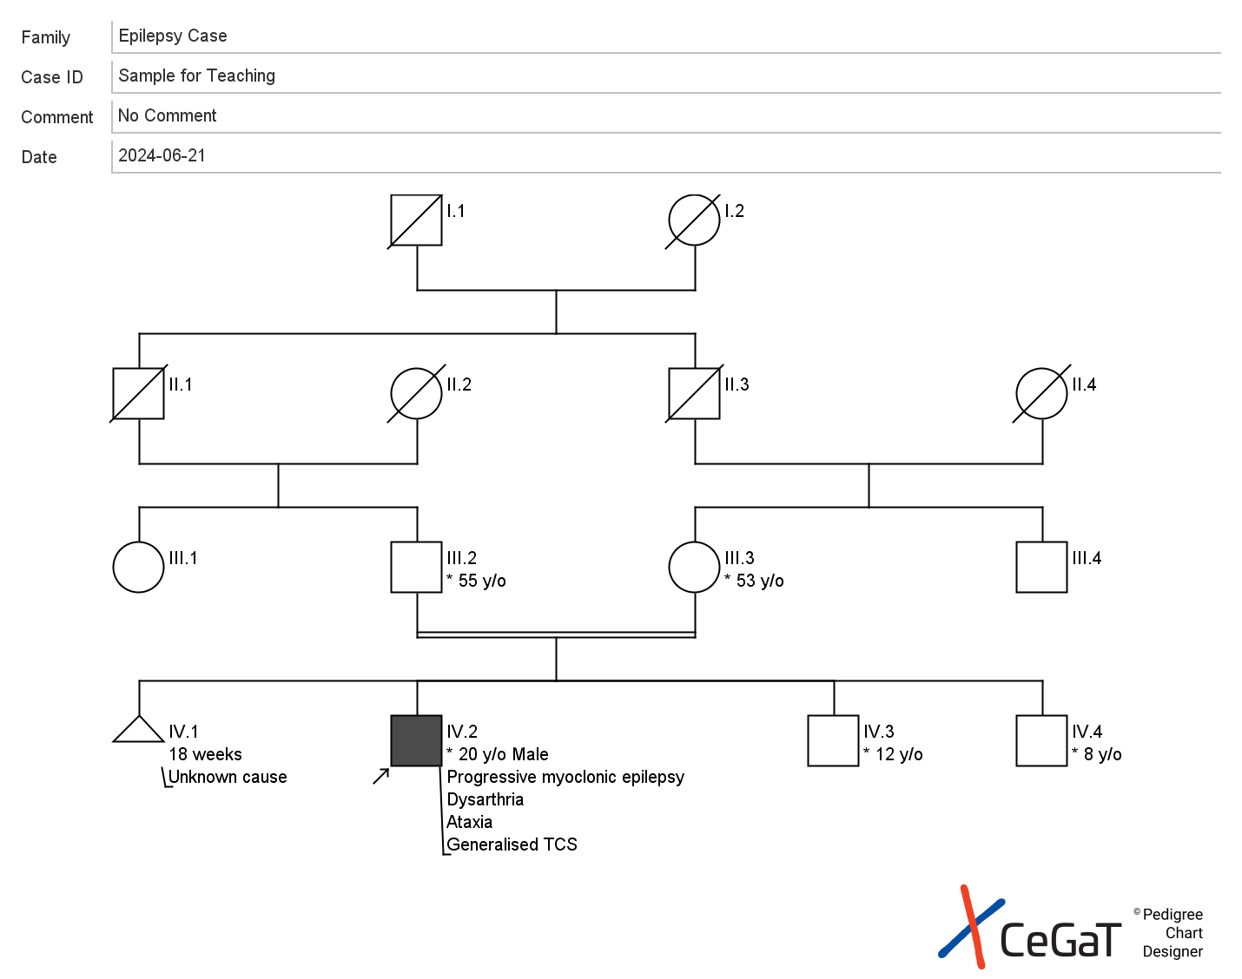
Case Study 1 & Ethical Considerations
PsychosocialHx: Lives with parents and 3 brothers.
FamilyHx:
Fundamentals of Genetics and Genomics (Genomics Nursing)
St George’s University Hospitals NHS Foundation Trust
Notes:
They live in a small close-knit community.

Slide 43

Case Study 1 & Ethical Considerations
Seen by the CNS & clinical geneticist. Genetic testing offered to proband and parents to investigate for syndromic epilepsy under R14.
Genetics report came back with homozygous biallelic single nucleotide nonsense pathogenic variant c.861G>A (p.Trp287Ter) in the EPM2A gene.
Confirms Lafora disease.
Fundamentals of Genetics and Genomics (Genomics Nursing)
St George’s University Hospitals NHS Foundation Trust

Slide 44
Case Study 1 & Ethical Considerations
Genetic Counselling:
Mode of Inheritance: Autosomal recessive.
Carriers are asymptomatic & not at risk of developing the disorder.
Each sibling of an affected individual has 25% chance of being affected, 50% chance of being an asymptomatic carrier, and 25% chance of being unaffected non-carrier.
Carrier testing for at-risk relatives, prenatal testing for at-risk pregnancies and PGD are possible.
Fundamentals of Genetics and Genomics (Genomics Nursing)
St George’s University Hospitals NHS Foundation Trust

Slide 45
Case Study 1 & Ethical Considerations
The course of the disease is characterized by increasing frequency and intractability of seizures.
Status epilepticus is common.
By their mid-twenties, most affected individuals are in a vegetative state with continuous myoclonus and require tube feeding. Some maintain minimal interactions with the family such as a reflex-like smiling upon cajoling. Affected individuals who are not tube-fed aspirate frequently as a result of seizures; death from aspiration pneumonia is common.
Most affected individuals die within ten years of onset, usually from status epilepticus or from complications related to nervous system degeneration [Turnbull et al 2016]. Variation by country in the care available for individuals with LD may influence longevity and disease complications.
Fundamentals of Genetics and Genomics (Genomics Nursing)
St George’s University Hospitals NHS Foundation Trust
Notes:
Turnbull J, Tiberia E, Striano P, Genton P, Carpenter S, Ackerley CA, Minassian BA. Lafora disease. Epileptic Disord. 2016;18:38–62.

Slide 46
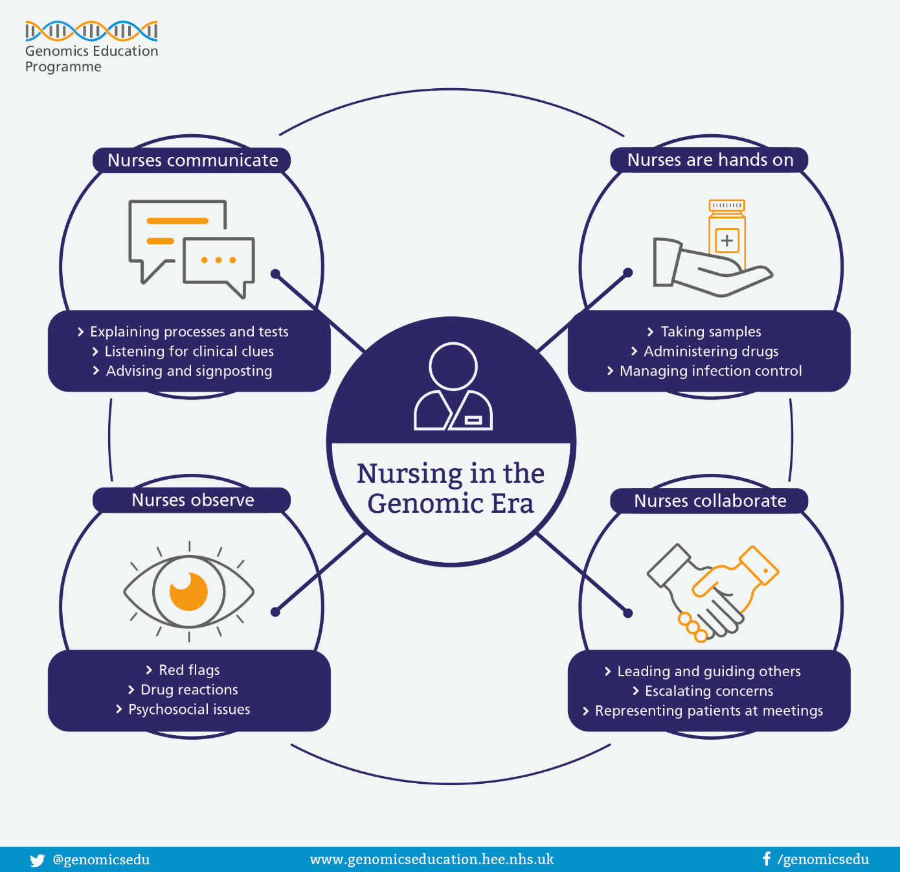
Case Study 1 & Ethical Considerations
What is your role as nurse when a patient receives a genetic diagnosis?
How would you support the family?
ABC vs St George’s Hospital (https://www.bbc.co.uk/news/health-50425039)
Fundamentals of Genetics and Genomics (Genomics Nursing)
St George’s University Hospitals NHS Foundation Trust

Slide 47
Useful Links
Southeast Genomics – Rare Disease WGS
Genomics Education Programme
Fundamentals of Genetics and Genomics (Genomics Nursing)

Slide 48




Contact Details
I want to know more!
Email: mark.mencias0@stgeorges.nhs.uk
mark.mencias@nhs.net
You can also find me on:
LinkedIn @markmencias
ResearchGate
Fundamentals of Genetics and Genomics (Genomics Nursing)

Slide 49
Thank you
Dr. Emma Matthews
Dr. Elizabeth Caruana-Galizia
Dr. Frances Elmslie
Dr. Meriel MacEntagart
Dr. Nayana Lahiri
Prof. Francesca Morgante
Aderonke Adebiyi RGN
Tinashe Samakomva RGN
Dr. Tootie Bueser RGN PhD
Andrea Foreman CGC
Heidi Brandon CGC
Atkinson Morley Regional Neurosciences Medical and Nursing Staff
Dr. Bridget Bax
Dr. Michio Hirano
Dr. Alan Pittman
Dr. Kate Everett
Dr. Kevin Blighe
St George’s Hospital NHS Foundation Trust.
SGH Clinical Research Facility
Genomics Education Programme
Health Education England
St George’s, University of London
King’s College London
The Lilly Foundation
Genetic Alliance UK
Medical Research Council
MD-UK & CMT-UK
Epilespy Action
Patient Advocacy Groups
Patients
Fundamentals of Genetics and Genomics (Genomics Nursing)

